Slide 1

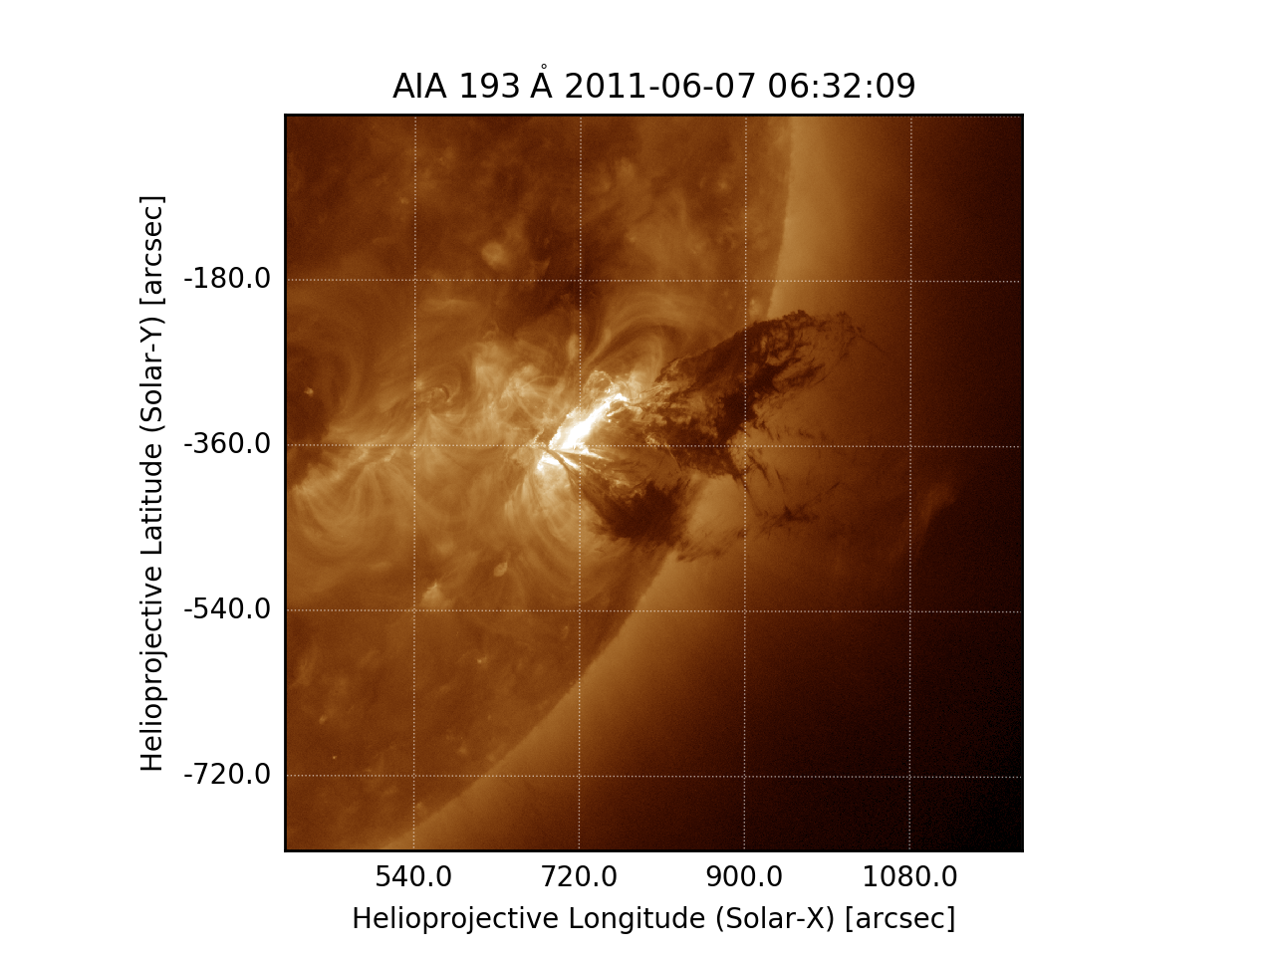
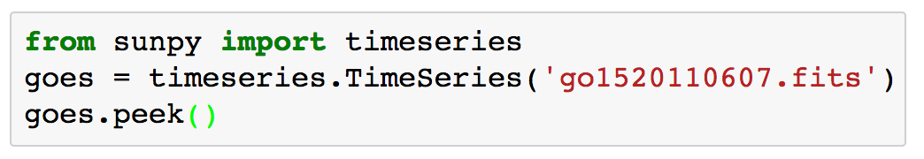
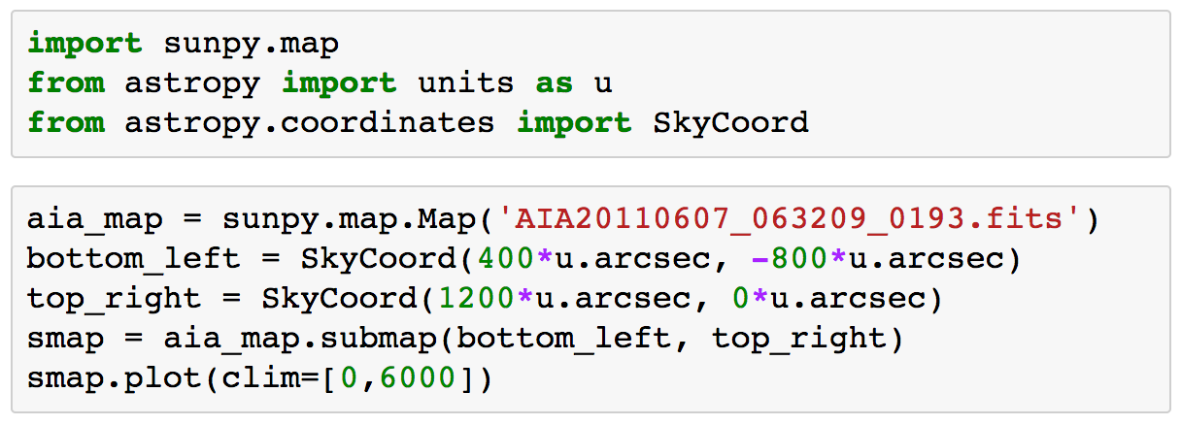
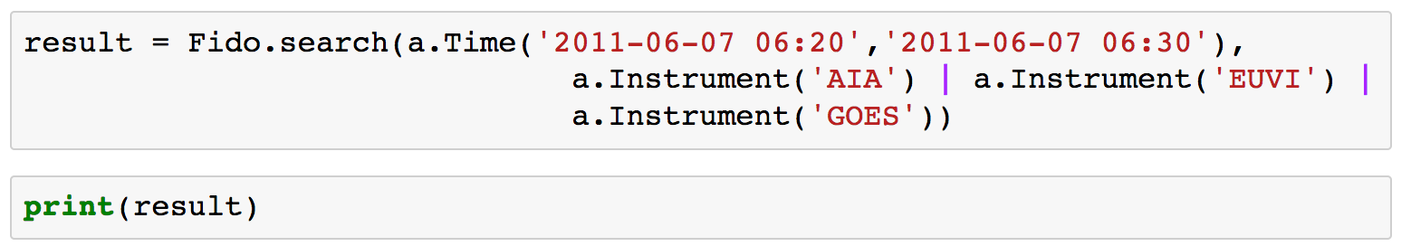
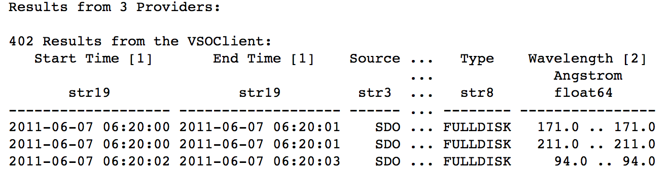
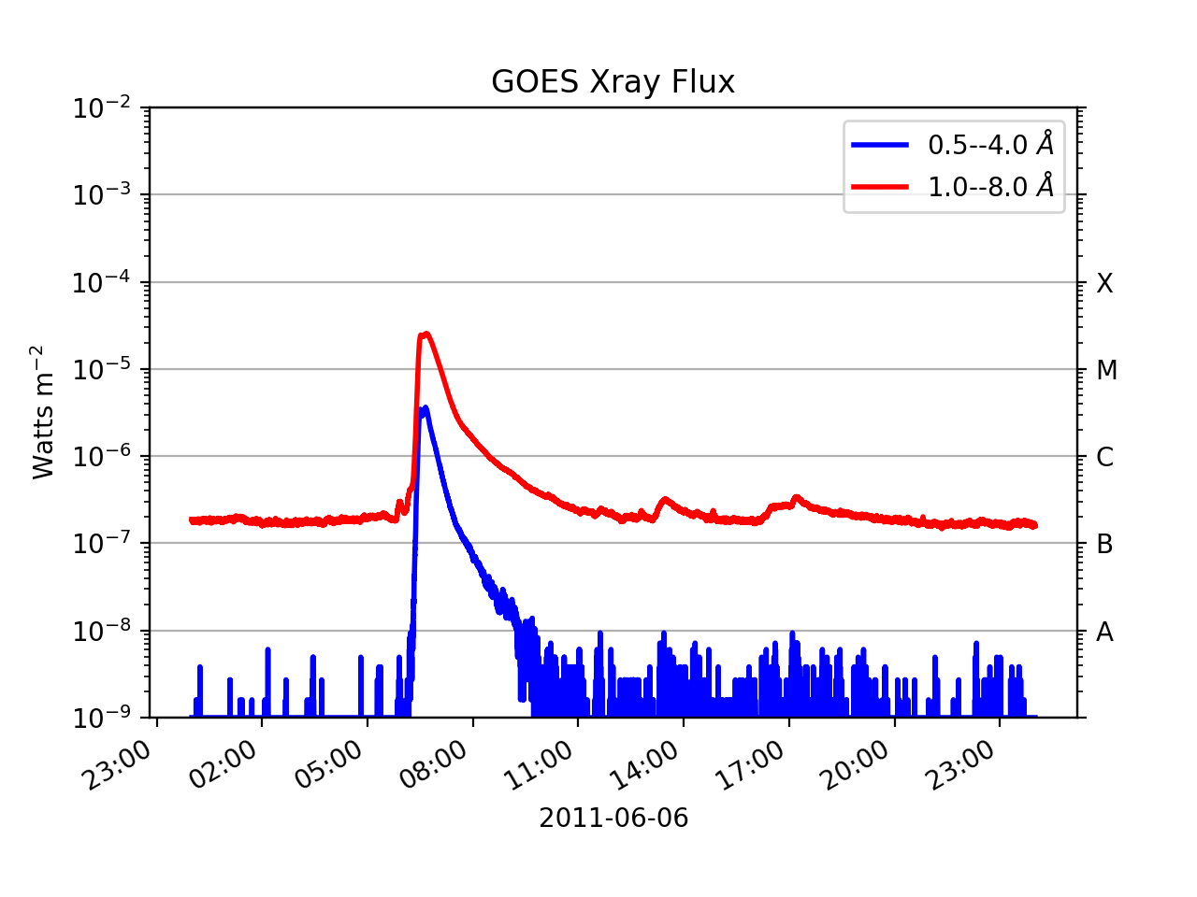
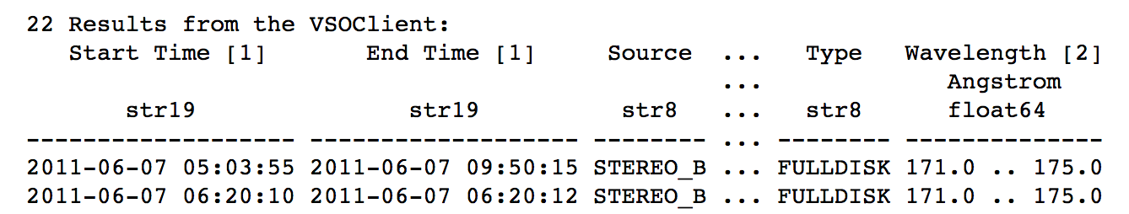
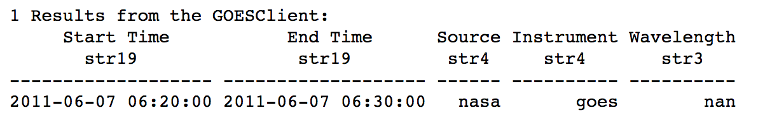

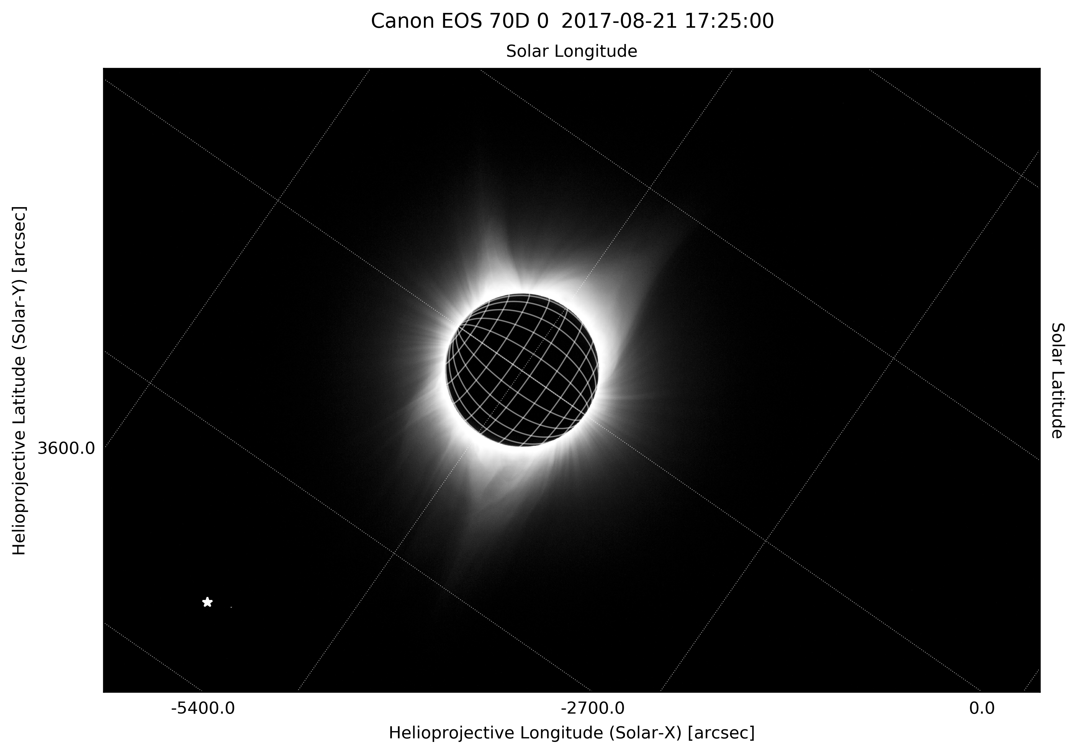
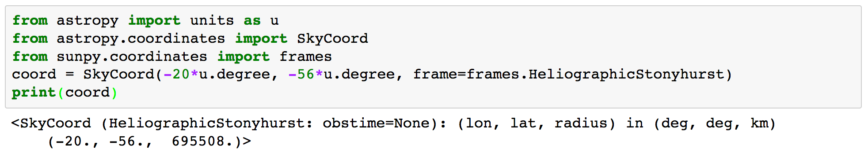
SunPy 0.8: Python for Solar Physics
Monica G. Bobra¹, Andrew R. Inglis², Stuart Mumford³, Steven Christe⁴, Nabil Freij⁵ , Russell Hewett⁶, Jack Ireland⁷, Juan Carlos Martínez Oliveros⁸, Kevin Reardon⁹, Sabrina Savage¹⁰, Albert Shih⁴, David Pérez-Suárez¹¹,
and the the SunPy Community
1. Stanford University, Stanford, CA, USA, 2. Catholic University of America, Washington, DC, USA, 3. University of Sheffield, Sheffield, UK, 4. NASA Goddard Space Flight Center, Greenbelt, MD, USA, 5. Universitat de les Illes Balears, Palma, Spain, 6. Total SA, Houston, TX, USA, 7. ADNET Systems Inc., Greenbelt, MD, USA, 8. University of California, Berkeley, CA, USA, 9. National Solar Observatory, Tucson, AZ, USA, 10. NASA Marshall Space Flight Center, Huntsville, AL, USA, 11. Mullard Space Science Laboratory, Dorking, UK.
SunPy is a community-developed open-source software library for solar physics. It is written in Python, a free, cross-platform, general-purpose, high-level programming language which is being increasingly adopted throughout the scientific community. SunPy aims to provide the software for obtaining and analyzing solar and heliospheric data. This poster introduces a new major release, SunPy version 0.8. The first major new feature introduced is Fido, the new primary interface to download data. It provides a consistent and powerful search interface to all major data providers including the VSO and the JSOC, as well as individual data sources such as GOES XRS time series. It is also easy to add new data sources as they become available, i.e. DKIST. The second major new feature is the SunPy coordinate framework. This provides a powerful way of representing coordinates, allowing simple and intuitive conversion between coordinate systems and viewpoints of different instruments (i.e., Solar Orbiter and the Parker Solar Probe), including transformation to astrophysical frames like ICRS. Other new features including new timeseries capabilities with better support for concatenation and metadata, updated documentation and example gallery. SunPy is distributed through pip and conda and all of its code is publicly available (sunpy.org).
Scientific Python
Get Involved
Programming in Python allows users to utilize a large and growing ecosystem of scientific packages already in place, including:
NumPy – for fast array operations
SciPy – for common scientific operations, e.g. curve fitting
Pandas – for time series manipulation
AstroPy, SpacePy, PlasmaPy – for astrophysical tools
Scikit-image, opencv, pillow – for image processing and computer vision
Scikit-learn, caffe – for machine learning
There are a number of ways to make your voice heard! We actively solicit code development and feedback from the community. We pride ourselves on being a welcoming community and we would love to have you become a part of this!
To get started, visit our website at sunpy.org or check out our documentation at docs.sunpy.org. If you’re interested in chatting with us, you can mail the general SunPy mailing list at sunpy@googlegroups.com or find us in our chat room at matrix.org.
Finally, come develop code or otherwise contribute to SunPy! The people who help develop or contribute to SunPy are varied in ability and experience. The Google Summer of Code (GSOC) and the European Summer of Code in Space (SOCIS) programs provided funding for over a dozen summer students to work on SunPy development since 2011.
SunPy 0.8 – what’s new?
We just released SunPy 0.8! The development of SunPy is a continuous, community-led process. For the latest release, there were 30+ contributors, with over 1300 commits to the codebase, addressing more than 160 issues. New headline features in 0.8 include:
Fido – the unified downloader
TimeSeries – an object for representing time-domain data
Map - an object for representing image data
The new package Fido is the primary interface to search for and download observational data irrespective of the underlying client or web service through which the data is obtained. Here is an example query:
The TimeSeries object is used to represent columns of time-ordered scalar values. Instantiate the TimeSeries object by passing in a file and has convenient plotting methods, e.g.:
The Map object in SunPy provides a convenient framework
for manipulating solar images from many sources, e.g.:
Use everything together to do cool stuff – like fitting your eclipse photos!
On the left is a photo of this summer’s total solar eclipse, as seen from a location about 60 miles north of Boise, Idaho, on August 21, 2017. This image was taken with a Canon EOS 70D by Steven Christe. On the right is the same photo, but fit to a helioprojective coordinate system via a SunPy Map object. This allows us to identify locations on the solar disk as well as other objects. For example, Regulus is indicated by the white star on the bottom left. For the entire code, see: https://github.com/ehsteve/solar-eclipse.
Coordinates – an object for representing coordinates
The SunPy coordinates package describes locations in physical space and coordinate frames. It provides a way to transform coordinates from one frame to another. Here we define an observer location using the SkyCoord object:
Citing SunPy
The continued growth and development of SunPy depends on community adoption and awareness. If you use SunPy in your work, we kindly ask that you acknowledge this with the following statement: “This research has made use of SunPy, an open-source and free community-developed solar data analysis package written in Python (citation).” The appropriate citation is as follows: The SunPy Community et al., Computational Science & Discovery, Volume 8, No. 1, 2015.

